Slide 1
the answer to life, the universe, and everything

Slide 2
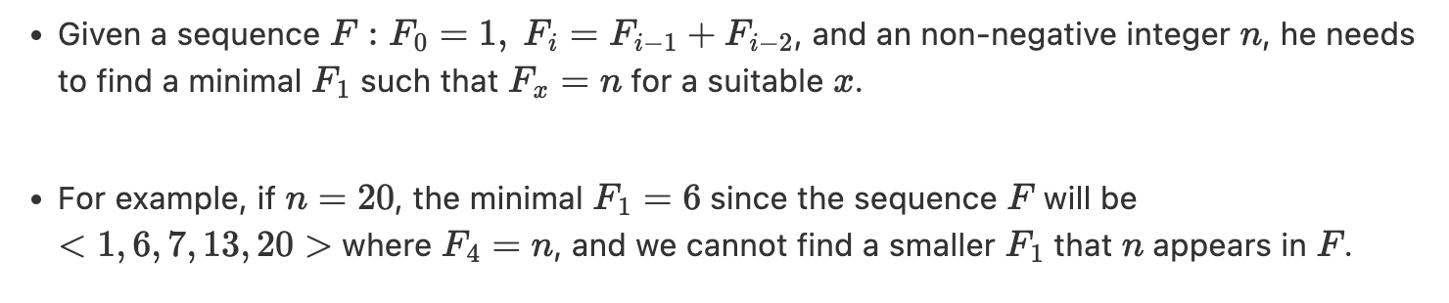
Requirements

Slide 3
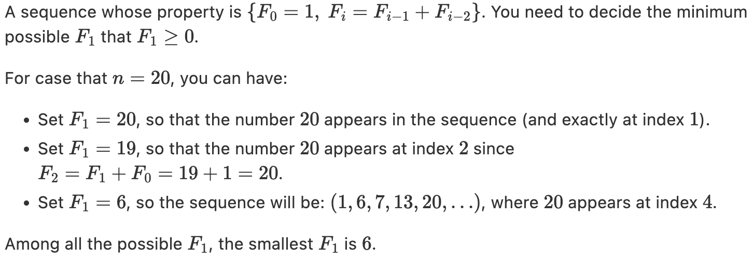
Requirements

Slide 4
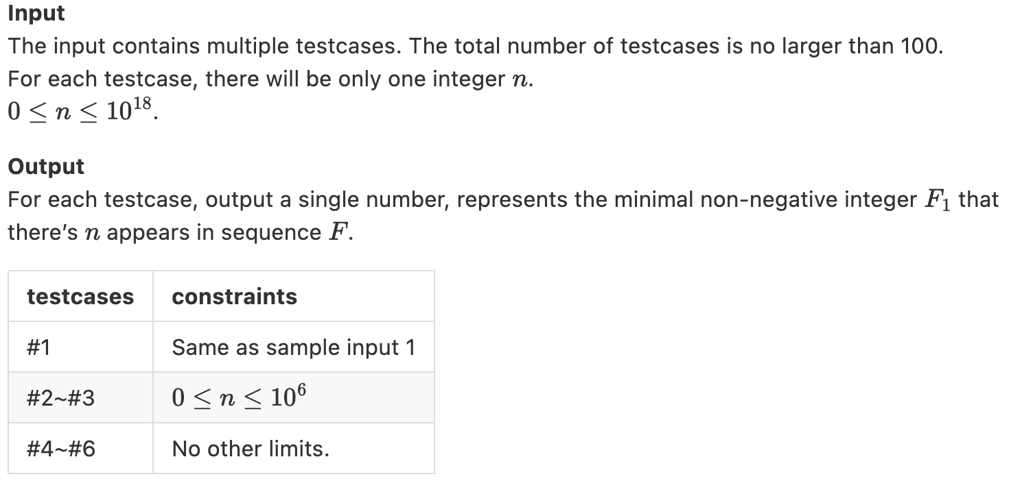
In / Out

Slide 5
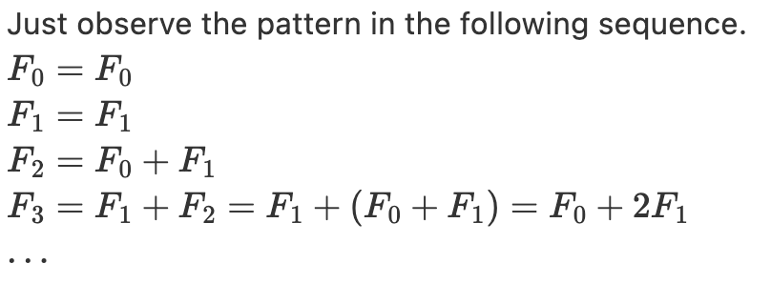
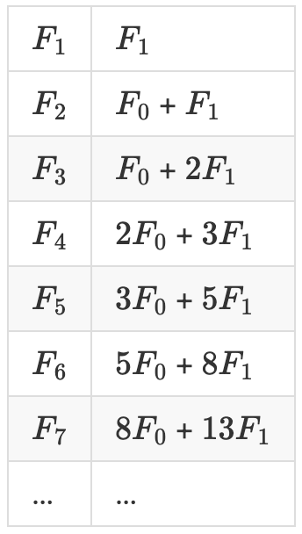
Solution

Slide 6
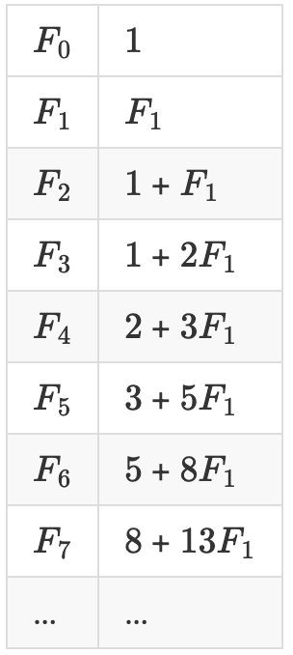
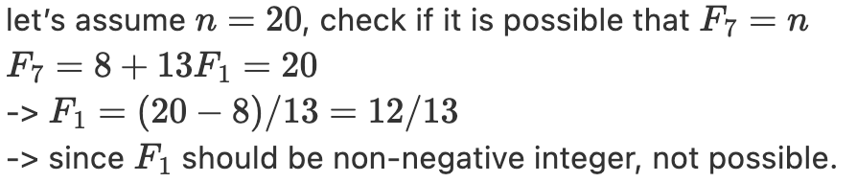
Solution

Slide 7
Pseudo code
long long F[102] int main() { F[0] = 1 // F: 1, 0, 1, 1, 2, 3, 5, 8, ... for i=2 to 102: F[i] = F[i-1] + F[i-2] for each input n: for i=100 to 0: if((n-F[i])>=0 && (n-F[i])%F[i+1]==0): print((n-F[i])/F[i+1]) }

